Slide 1
Daily Review – Solubility
Soluble substances are ones that dissolve in a liquid
Insoluble substances are ones that don’t dissolve in a liquid
On your whiteboard, list three substances that are soluble in water and three substances that are insoluble in water.
Think, Pair, Share: How could you make more of a substance dissolve in the same amount of water?

Slide 2
Daily Review
CFU 1
Is the mixture a solution and you want the solute?
Which technique?
A chemist has contaminated her sulfuric acid with methanol. She needs the sulfuric acid for her next experiment. What separation technique should she use?
CFU 1
Does the liquid with the higher or lower boiling point need to be kept?
Identifying a separation technique
1. For a solution, and you want the solute: crystallisation 2. For liquids with different boiling points: a) you want the one with the higher boiling point = evaporation b) you want the one with the lowest boiling point = distillation
Substance | Boiling Point (°C)
chloroform | 61.2
methanol | 64.7
nitric acid | 83
petrol | 95
sulfuric acid | 337
water | 100

Slide 3

Daily Review
CFU 1
Is the mixture a solution and you want the solute?
Which technique?
A company wants to produce sea salt from sea water. What separation technique would you suggest they use and why?
CFU 1
Does the liquid with the higher or lower boiling point need to be kept?
Identifying a separation technique
1. For a solution, and you want the solute: crystallisation 2. For liquids with different boiling points: a) you want the one with the higher boiling point = evaporation b) you want the one with the lowest boiling point = distillation

Slide 4
Daily Review
CFU 1
Is the mixture a solution and you want the solute?
Which technique?
The same company decides they can make more money if they collect and sell the water as well as the salt from the sea water. What should they do? Explain your choice.
CFU 1
Does the liquid with the higher or lower boiling point need to be kept?
Identifying a separation technique
1. For a solution, and you want the solute: crystallisation 2. For liquids with different boiling points: a) you want the one with the higher boiling point = evaporation b) you want the one with the lowest boiling point = distillation

Slide 5
Separating Mixtures: Chromatography Year 7 Science

Slide 6
Learning Objectives
CFU
What are we going to learn today?
Describe how to separate mixtures using chromatography.
Describe chromatograms.
Activate Prior Knowledge
Solubility describes how easily a substance dissolves in a solvent.
On your whiteboard, name two solutes that easily dissolve in water (solvent)

Slide 7
Concept Development
CFU 1
What are dyes made from?
Chromatography
Many dyes are small particles that are dissolved in a solvent
Some dyes have a higher solubility than others
This can be used to separate them from each other
CFU 2
What can be used to separate the dyes?
Vocabulary
Solubility: how easily a substance dissolves

Slide 8
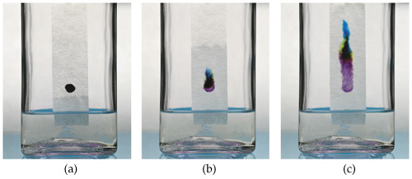
Concept Development
CFU 1
What is the first step in chromatography?
Chromatography
A spot of dye is put on the end of a piece of absorbent paper
The end of the paper is dipped in water and the water moves slowly up the paper.
As the water moves past the dye mixture, the most soluble dye dissolves first and starts to move with the water.
CFU 2
What do you do with the paper?
CFU 2
Which type of dye dissolves first in the water, the most or least soluble?
Vocabulary
Soluble: Dissolves in a liquid

Slide 9
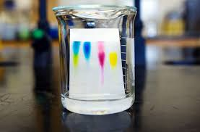
Concept Development
CFU 1
Which type of dye dissolves last in the water, the most or least soluble?
Chromatography
The less soluble dyes take longer to dissolve.
As each dye dissolves it starts to move up the paper creating a series of individual colours
CFU 2
Is the most soluble dye at the top of the paper or the bottom of the paper? Explain your choice.
Vocabulary
Soluble: Dissolves in a liquid

Slide 10
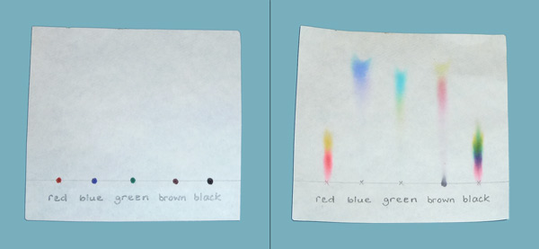
Skill Development/Guided Practice
Vocabulary
Chromatogram: pattern of separated substances from chromatography
CFU 1
What is the original colour?
Describing Chromatograms
Describe the chromatogram for the red dye.
CFU 2
What colours has it separated into?
The red dye mixture has separated into yellow and red. The yellow dye is more soluble than the red because it has moved further on the paper.
Describing Chromatograms
Step 1: Identify the original colour of the dye mixture Step 2: Identify the colours in the separated dye sample Step 3: Describe the solubility of individual dyes if there is more than one in the sample
CFU 3
What colour is more soluble? How do you know?

Slide 11
Skill Development/Guided Practice
Vocabulary
Chromatogram: pattern of separated substances from chromatography
CFU 1
What is the original colour?
Describing Chromatograms
Describe the chromatogram for the green dye.
CFU 2
What colours has it separated into?
The green dye mixture has separated into yellow and blue. The blue dye is more soluble than the yellow because it has moved further on the paper.
Describing Chromatograms
Step 1: Identify the original colour of the dye mixture Step 2: Identify the colours in the separated dye sample Step 3: Describe the solubility of individual dyes if there is more than one in the sample
CFU 3
What colour is more soluble? How do you know?

Slide 12
Skill Development/Guided Practice
Vocabulary
Chromatogram: pattern of separated substances from chromatography
CFU 1
What is the original colour?
Describing Chromatograms
Describe the chromatogram for the blue dye.
CFU 2
What colours has it separated into?
The blue dye mixture has not separated. There is only one colour in the blue dye.
Describing Chromatograms
Step 1: Identify the original colour of the dye mixture Step 2: Identify the colours in the separated dye sample Step 3: Describe the solubility of individual dyes if there is more than one in the sample
CFU 3
What colour is more soluble? How do you know?

Slide 13
Skill Development/Guided Practice
Vocabulary
Chromatogram: pattern of separated substances from chromatography
CFU 1
What is the original colour?
Describing Chromatograms
Describe the chromatogram for the brown dye.
CFU 2
What colours has it separated into?
Describing Chromatograms
Step 1: Identify the original colour of the dye mixture Step 2: Identify the colours in the separated dye sample Step 3: Describe the solubility of individual dyes if there is more than one in the sample
CFU 3
What colour is more soluble? How do you know?

Slide 14
Skill Development/Guided Practice
Vocabulary
Chromatogram: pattern of separated substances from chromatography
CFU 1
What is the original colour?
Describing Chromatograms
Describe the chromatogram for the black dye.
CFU 2
What colours has it separated into?
Describing Chromatograms
Step 1: Identify the original colour of the dye mixture Step 2: Identify the colours in the separated dye sample Step 3: Describe the solubility of individual dyes if there is more than one in the sample
CFU 3
What colour is more soluble? How do you know?

Slide 15
Relevance
More complex and sensitive chromatography instruments are used in many industries. They are used to:
Testing for pollutants in air
Testing urine to identify athletes using banned substances
Testing for drugs at airports
Analysing vitamin and mineral content in foods
Testing artworks for forgeries
You will be conducting a simple chromatography experiment.

Slide 16

Skill Closure
Vocabulary
Soluble: dissolves in a solvent
Name a substance that is soluble in water and one that is not.
Skill Closure
Why are the parts of a mixture of dyes able to be separated?
Skill Closure
Explain how chromatography works to separate dyes. (Think, Pair, Whiteboard, Share)
Describing Chromatograms
Step 1: Identify the original colour of the dye mixture Step 2: Identify the colours in the separated dye sample Step 3: Describe the solubility of individual dyes
Vocabulary
Chromatogram: pattern of separated substances from chromatography
Skill Closure
The first dye in the chromatogram is green. Describe the chromatogram.

Slide 17
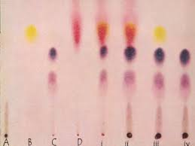
Independent Practice
Complete the worksheet on chromatography. (Available on Connect or get a copy from your teacher)
Turn to page 41 in your textbooks and attempt Questions 1-6.

